Slide 1
Customer Shopping Data Analysis
Internship Project June-2026
PRDA-05-Customer Data Analysis
Submitted By: Deepak R Rayabagkar
Tools Used: SQL | Power Bi | Power Query | DAX
Dataset Source: MySQL Database(99,457 Records)

Slide 2
Project overview and Objective
This project analyzes customer shopping behavior using SQL and Power BI. It examines customer
demographics, product categories, payment methods, and revenue to identify shopping patterns
and generate meaningful business insights through an interactive dashboard.
Analyze customer shopping behavior by gender and age.
Identify high-revenue product categories.
Compare revenue and products sold across customer segments.
Study payment method preferences.
Build an interactive Power BI dashboard for business insights and decision-making.

Slide 3
Dataset Overview: Dataset Source: MySQL Database Total Records: 99,457 Transactions
Attribute Information:
invoice_no: A combination of the letter 'I' and a 6-digit integer uniquely assigned to each operation.
customer_id: A combination of the letter 'C' and a 6-digit integer uniquely assigned to each operation.
gender: String variable of the customer's gender.
age: Positive Integer variable of the customers age.
category: String variable of the category of the purchased product.
quantity: The quantities of each product (item) per transaction.
price: Product price per unit in Turkish Liras (TL).
payment_method: String variable of the payment method (cash, credit card or debit card) used for the transaction.
invoice_date: The day when a transaction was generated.
shopping_mall: String variable of the name of the shopping mall where the transaction was made.

Slide 4
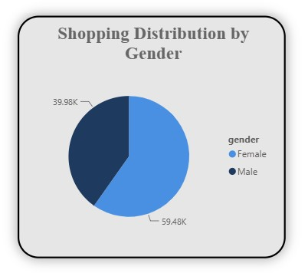
Shopping Distribution by Gender
Insights :
Female customers account for the highest shopping transactions with 59.48K purchases.
Male customers contributed 39.98K shopping transactions, which is significantly lower than female customers.
Female customers represent approximately 60% of total shopping transactions, while male customers account for around 40%.
The shopping data indicates that female customers are the dominant customer segment in terms of shopping frequency.
The company has a stronger customer engagement among female shoppers, making them a key target audience for marketing and promotional campaigns.

Slide 5
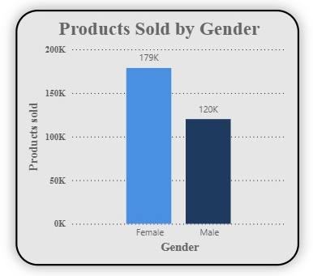
Products Sold by Gender
Insights :
Female customers purchased approximately 179K products, which is the highest among all customer segments.
Male customers purchased around 120K products, significantly fewer than female customers.
Female customers contributed nearly 60% of the total products sold, indicating higher purchasing activity.
The difference of about 59K products between female and male customers suggests stronger product demand from female shoppers.

Slide 6
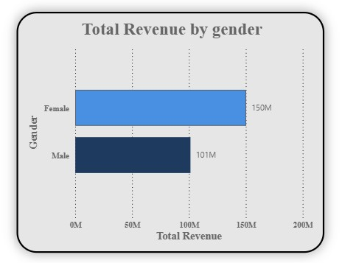
Total Revenue by Gender
Insights – Total Revenue by Gender
Female customers generated the highest total revenue of approximately 150M, outperforming male customers.
Male customers generated around 101M in total revenue, which is considerably lower than female customers.
Female customers contributed nearly 60% of the overall revenue, making them the primary revenue-generating customer segment.
The revenue difference of approximately 49M between female and male customers indicates stronger purchasing power and/or higher shopping frequency among female customers.

Slide 7
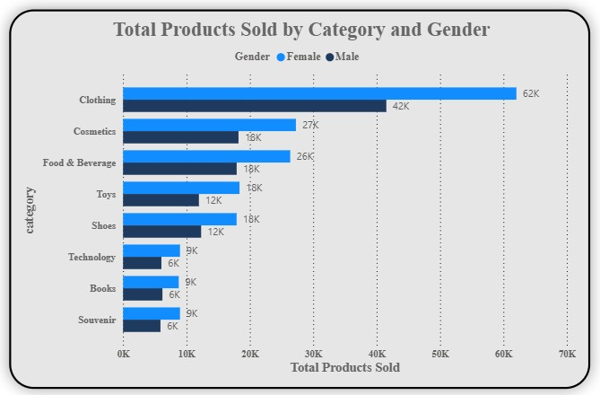
Total Products sold by Category & Gender
Insights :
Clothing is the highest-selling product category, with approximately 62K products sold to female customers and 42K to male customers, making it the most popular category overall.
Female customers purchased more products than male customers across every product category, indicating consistently higher purchasing activity.
Cosmetics (27K) and Food & Beverage (26K) are the next most popular categories among female customers, while male customers purchased approximately 18K products in each of these categories.
Toys and Shoes recorded moderate sales, with female customers purchasing around 18K products compared to 12K by male customers.
Technology, Books, and Souvenirs are the least purchased categories, with female customers buying approximately 9K products and male customers around 6K in each category.
The analysis indicates that female customers are the primary contributors to product sales across all categories, with the largest gender gap observed in the Clothing category.

Slide 8
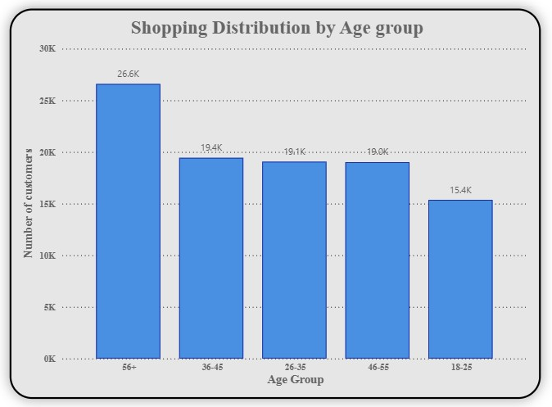
Shopping Distribution by Age
Insights :
Customers aged 56+ recorded the highest shopping activity, with approximately 26.6K transactions, making them the most active customer segment.
The 36–45, 26–35, and 46–55 age groups showed similar shopping activity, with around 19K transactions each, indicating consistent purchasing behavior across these age groups.
The 18–25 age group recorded the lowest shopping activity, with approximately 15.4K transactions, suggesting lower participation compared to older age groups.
The shopping distribution indicates that middle-aged and senior customers contribute the majority of shopping transactions, highlighting them as the company's core customer base.
The relatively balanced transaction counts among the 26–55 age groups suggest a stable customer distribution, while the 56+ segment stands out as the most engaged in terms of shopping frequency.

Slide 9
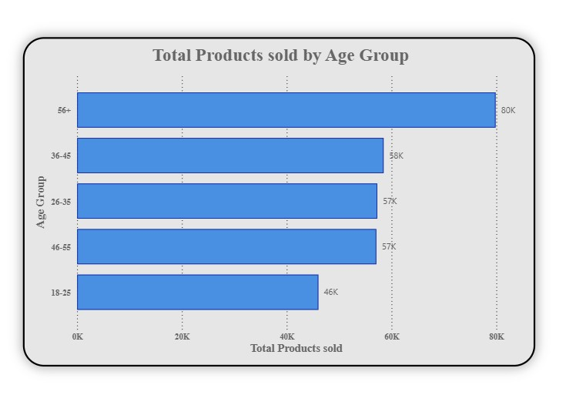
Products sold by Age
Insights :
Customers aged 56+ purchased the highest number of products, with approximately 80K products sold, making them the most valuable customer segment in terms of product purchases.
The 36–45 age group ranked second, purchasing around 58K products, followed closely by the 26–35 and 46–55 age groups with 57K products each.
The 18–25 age group purchased the fewest products, with approximately 46K products sold, indicating comparatively lower buying activity.
The product sales across the 26–55 age groups are relatively consistent, suggesting a stable purchasing pattern among middle-aged customers.
The analysis indicates that older customers (56+) contribute significantly more to product sales than other age groups, making them an important customer segment for sales growth and customer retention strategies.

Slide 10
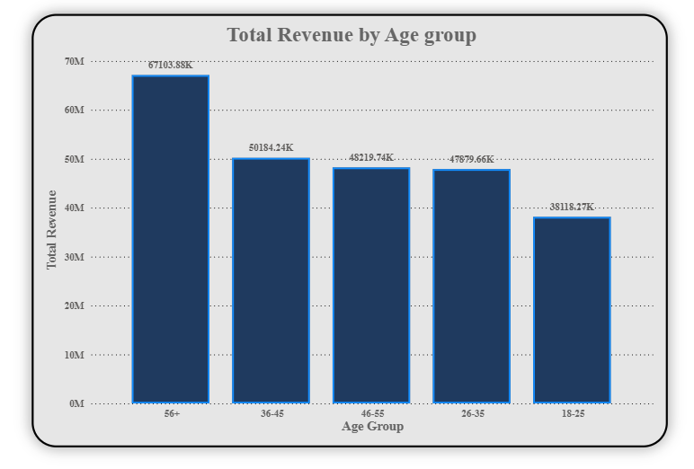
Revenue Generated by Age
Insights :
Customers aged 56+ generated the highest revenue, contributing approximately 67.1M, making them the most valuable customer segment.
The 36–45 age group ranked second, generating around 50.2M in total revenue.
The 46–55 and 26–35 age groups generated 48.2M and 47.9M respectively, indicating similar spending patterns.
The 18–25 age group generated the lowest revenue, contributing approximately 38.1M, suggesting lower purchasing power or fewer purchases.
The analysis shows that revenue generally increases with age, with customers aged 36 years and above contributing the majority of the company's total revenue.
The 56+ age group stands out as the highest revenue-generating segment, making them a key customer group for customer retention, loyalty programs, and premium product offerings.

Slide 11
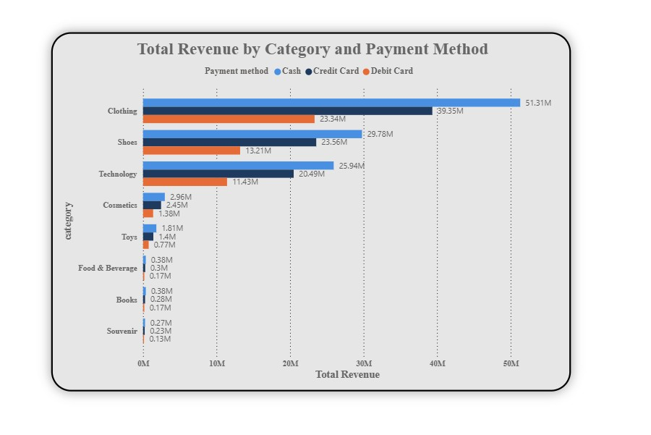
Revenue Generated by Category & Payment Method
Insights :
Clothing generated the highest revenue across all payment methods, with Cash (51.31M) contributing the most, followed by Credit Card (39.35M) and Debit Card (23.34M).
Shoes and Technology are the second and third highest revenue-generating categories, indicating strong customer demand after Clothing.
Cash is the most preferred payment method across almost all product categories, consistently generating higher revenue than Credit Card and Debit Card.
Credit Card transactions generated higher revenue than Debit Card across every product category, making it the second most preferred payment method.
Books, Souvenirs, Food & Beverage, and Toys contributed comparatively lower revenue, suggesting lower customer spending in these categories.
The analysis indicates that high-value product categories such as Clothing, Shoes, and Technology account for the majority of total revenue, regardless of the payment method used.

Slide 12
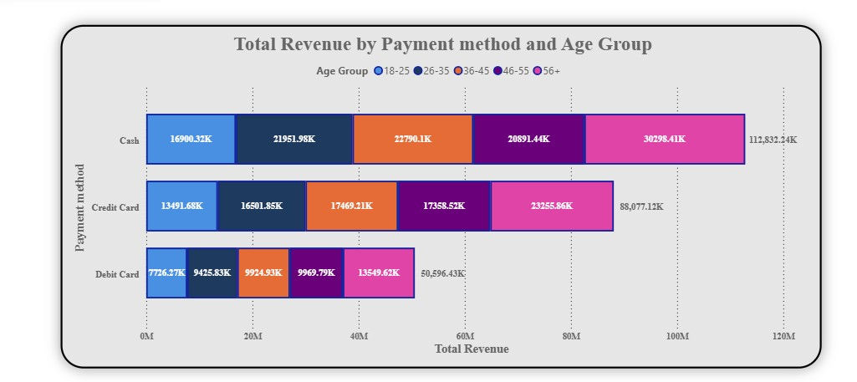
Payment Method Related to Revenue & Age
Insights :
Cash generated the highest total revenue (approximately 112.83M), making it the most preferred payment method across all age groups.
Credit Card ranked second, contributing approximately 88.08M, while Debit Card generated the lowest revenue at around 50.60M.
The 56+ age group contributed the highest revenue across all payment methods, with 30.30M (Cash), 23.26M (Credit Card), and 13.55M (Debit Card).
The 18–25 age group generated the lowest revenue for each payment method, indicating lower spending compared to older customer segments.
Revenue consistently increases with age across all payment methods, highlighting that middle-aged and senior customers contribute more to the company's sales.

Slide 13
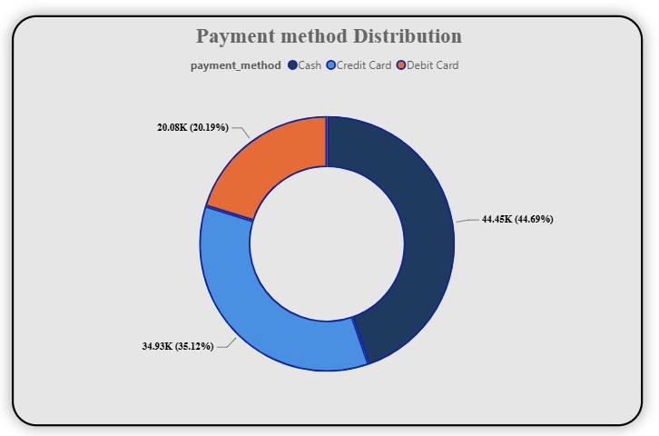
Distribution of Payment Method
Insights :
Cash is the most preferred payment method, accounting for 44.45K transactions (44.69%), making it the dominant mode of payment.
Credit Card is the second most preferred payment method, with 34.93K transactions (35.12%), indicating strong customer adoption of card payments.
Debit Card is the least preferred payment method, contributing 20.08K transactions (20.19%) of the total transactions.
Nearly 80% of all transactions were completed using either Cash or Credit Card, highlighting a strong customer preference for these payment methods.
The distribution suggests that customers are more inclined to use Cash and Credit Cards, while Debit Card usage remains comparatively low.

Slide 14
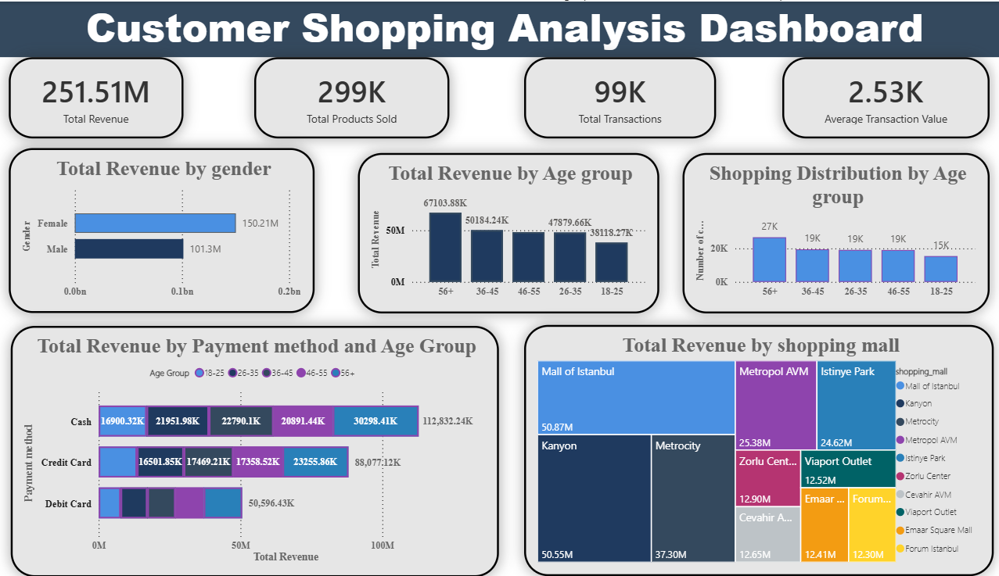

Slide 15
Overall Insights
Female customers are the primary contributors to the business, generating the highest number of shopping transactions, products sold, and total revenue.
Customers aged 56 years and above are the most valuable customer segment, leading in shopping frequency, product purchases, and overall revenue generation.
Clothing is the best-performing product category, followed by Shoes and Technology, making these the key revenue-driving categories.
Cash is the most preferred payment method, followed by Credit Card, while Debit Card has the lowest customer usage.
Customer purchasing behavior varies across age groups and product categories, providing valuable insights for targeted marketing, inventory planning, and business growth.

Slide 16
Business Recommendations
Focus marketing campaigns on female customers to maximize revenue and strengthen customer loyalty.
Retain high-value customers aged 56+ through loyalty programs, exclusive offers, and personalized services.
Increase inventory and promotional efforts for high-performing categories such as Clothing, Shoes, and Technology to boost sales.
Develop targeted campaigns for the 18–25 age group using discounts, digital promotions, and personalized offers to increase engagement and spending.
Encourage the use of digital payment methods, especially Debit Cards, through cashback offers and promotional incentives while continuing to support customers' preferred payment options.

